Slide 1
CS209: Computer Science II

Slide 2
Unit 3 Module 3:
Recursion
Introducing Recursion
Solving Problems with Recursion
Solving Recursively Defined Problems
Linked Listed Recursion
Binary Search
Towers of Hanoi
Quicksort

Slide 3
Recursion
"The power of recursion evidently lies in the possibility of defining an infinite set of objects by a finite statement. In the same manner, an infinite number of computations can be described by a finite recursive program, even if this program contains no explicit repetitions.“
Wirth, Niklaus (1976). Algorithms + Data Structures = Programs. Prentice-Hall. p. 126.
Recursion is a method where the solution to a problem depends on solutions to smaller instances of the same problem

Slide 4
Introduction to Recursion
A recursive function contains a call to itself:
void countDown(int num)
{
if (num == 0)
cout << "Blastoff!";
else
{
cout << num << "...\n";
countDown(num-1); // recursive
} // call
}

Slide 5
What Happens When Called?
If a program contains a line like countDown(2);
countDown(2) generates the output 2..., then it calls countDown(1)
countDown(1) generates the output 1..., then it calls countDown(0)
countDown(0) generates the output Blastoff!, then returns to countDown(1)
countDown(1) returns to countDown(2)
countDown(2)returns to the calling function

Slide 6
What Happens When Called?
first call to
countDown
num is 2
output:
2...
countDown(1);
second call to
countDown
num is 1
1...
countDown(0);
third call to
countDown
num is 0
Blastoff!
// no
// recursive
// call

Slide 7
Introduction to Recursion
Recursion
In C++ a function definition may contain a call to the function being defined. In such cases the function is said to be recursive.
A recursive function named writeVertical that takes one (nonnegative) int argument and writes that int to the screen, with the digits going down the screen one per line. For example, the invocation writeVertical(1234);
would produce the output
1
2
3
4

Slide 8
Introduction to Recursion
The task to be performed by writeVertical may be broken down into the following two cases:
■ Simple case: If n < 10, then write the number n to the screen.
After all, if the number is only one digit long, the task is trivial.
■ Recursive case: If n >= 10, then do two subtasks:
1. Output all the digits except the last digit.
2. Output the last digit.

Slide 9
Introduction to Recursion
if (n < 10)
{
cout << n << endl;
}
else //n is two or more digits long:
{
writeVertical ( the number n with the last digit removed );
cout << the last digit of n << endl;

Slide 10
Introduction to Recursion
if (n < 10)
{
cout << n << endl;
}
else //n is two or more digits long:
{
writeVertical ( the number n with the last digit removed );
cout << the last digit of n << endl;
n / 10 is the number n with the last digit removed.
n % 10 is the last digit of n .

Slide 11
Introduction to Recursion
The complete code for the function is as follows:
void writeVertical( int n)
{
if (n < 10)
{
cout << n << endl;
}
else //n is two or more digits long :
{
writeVertical(n / 10);
cout << (n % 10) << endl;
}
}

Slide 12
19.2
Solving Problems with Recursion

Slide 13
Recursive Functions - Purpose
Recursive functions are used to reduce a complex problem to a simpler-to-solve problem.
The simpler-to-solve problem is known as the base case
Recursive calls stop when the base case is reached

Slide 14
Stopping the Recursion
A recursive function must always include a test to determine if another recursive call should be made, or if the recursion should stop with this call
In the sample program, the test is:
if (num == 0)

Slide 15
Stopping the Recursion
void countDown(int num)
{
if (num == 0) // test
cout << "Blastoff!";
else
{
cout << num << "...\n";
countDown(num-1); // recursive
} // call
}

Slide 16
Stopping the Recursion
Recursion uses a process of breaking a problem down into smaller problems until the problem can be solved
In the countDown function, a different value is passed to the function each time it is called
Eventually, the parameter reaches the value in the test, and the recursion stops

Slide 17
Stopping the Recursion
void countDown(int num)
{
if (num == 0)
cout << "Blastoff!";
else
{
cout << num << "...\n";
countDown(num-1);// note that the value
} // passed to recursive
} // calls decreases by
// one for each call

Slide 18
What Happens When Called?
Each time a recursive function is called, a new copy of the function runs, with new instances of parameters and local variables created
As each copy finishes executing, it returns to the copy of the function that called it
When the initial copy finishes executing, it returns to the part of the program that made the initial call to the function

Slide 19
What Happens When Called?
first call to
countDown
num is 2
output:
2...
countDown(1);
second call to
countDown
num is 1
return
1...
countDown(0);
third call to
countDown
num is 0
return
Blastoff!
// no
// recursive
// call
return

Slide 20
Types of Recursion
Direct
a function calls itself
Indirect
function A calls function B, and function B calls function A
function A calls function B, which calls …, which calls function A

Slide 21
The Recursive Factorial Function
The factorial function:
n! = n*(n-1)*(n-2)*...*3*2*1 if n > 0
n! = 1 if n = 0
Can compute factorial of n if the factorial of (n-1) is known:
n! = n * (n-1)!
n = 0 is the base case

Slide 22
The Recursive Factorial Function
int factorial (int num)
{
if (num > 0)
return num * factorial(num - 1);
else
return 1;
}

Slide 23
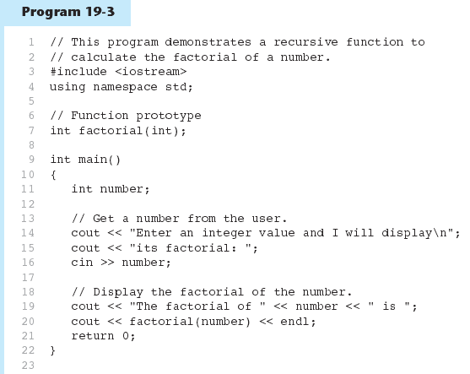

Slide 24
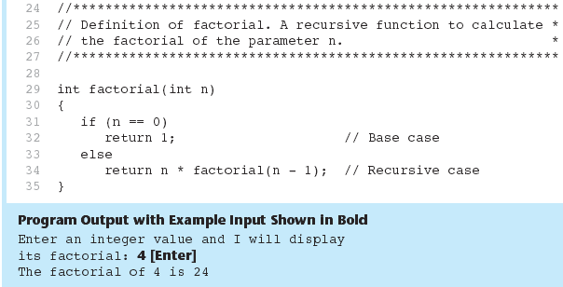
Program 19-3 (Continued)

Slide 25
Tracing Recursion – another look
writeVertical(123);
if (123 < 10)
{
cout << 123 << endl;
}
else //n is two or more digits long:
{
writeVertical(123 / 10);
cout << (123 % 10) << endl;
}

Slide 26
Tracing Recursion – another look
writeVertical(123);
if (123 < 10)
{
cout << 123 << endl;
}
else //n is two or more digits long:
{
writeVertical(123 / 10);
cout << (123 % 10) << endl;
}
writeVertical(12);

Slide 27
Tracing Recursion – another look
if (12 < 10)
{
cout << 12 << endl;
}
else //n is two or more digits long:
{
cout << (123 % 10) << endl;
}
writeVertical(12);

Slide 28
Tracing Recursion – another look
if (123 < 10)
{
cout << 123 << endl;
}
else //n is two or more digits long:
{
writeVertical(12 / 10);
cout << (123 % 10) << endl;
}
if (12 < 10)
{
cout << 12 << endl;
}
else //n is two or more digits long:
{
writeVertical(12 / 10);
cout << (12 % 10) << endl;
}
writeVertical(1);

Slide 29
Tracing Recursion – another look
if (123 < 10)
{
cout << 123 << endl;
}
else //n is two or more digits long:
{
writeVertical(12 / 10);
cout << (123 % 10) << endl;
}
if (12 < 10)
{
cout << 12 << endl;
}
else //n is two or more digits long:
{
writeVertical(12 / 10);
cout << (12 % 10) << endl;
}
if (1 < 10)
{
cout << 1 << endl;
}
else //n is two or more digits long:
{
writeVertical(1 / 10);
cout << (1 % 10) << endl;
}

Slide 30
Tracing Recursion – another look
if (123 < 10)
{
cout << 123 << endl;
}
else //n is two or more digits long:
{
writeVertical(12 / 10);
cout << (123 % 10) << endl;
}
if (12 < 10)
{
cout << 12 << endl;
}
else //n is two or more digits long:
{
writeVertical(12 / 10);
cout << (12 % 10) << endl;
}

Slide 31
Tracing Recursion – another look
if (123 < 10)
{
cout << 123 << endl;
}
else //n is two or more digits long:
{
writeVertical(12 / 10);
cout << (123 % 10) << endl;
}

Slide 32
Tracing Recursion – another look
writeVertical(123);
if (123 < 10)
{
cout << 123 << endl;
}
else //n is two or more digits long:
{
writeVertical(123 / 10);
cout << (123 % 10) << endl;
}

Slide 33
19.3
The Recursive gcd Function

Slide 34
The Recursive gcd Function
Greatest common divisor (gcd) is the largest factor that two integers have in common
Computed using Euclid's algorithm:
gcd(x, y) = y if y divides x evenly
gcd(x, y) = gcd(y, x % y) otherwise
gcd(x, y) = y is the base case

Slide 35
The Recursive gcd Function
int gcd(int x, int y)
{
if (x % y == 0)
return y;
else
return gcd(y, x % y);
}

Slide 36
19.4
Solving Recursively Defined Problems

Slide 37
Solving Recursively Defined Problems
The natural definition of some problems leads to a recursive solution
Example: Fibonacci numbers:
0, 1, 1, 2, 3, 5, 8, 13, 21, ...
After the starting 0, 1, each number is the sum of the two preceding numbers
Recursive solution:
fib(n) = fib(n – 1) + fib(n – 2);
Base cases: n <= 0, n == 1

Slide 38
Solving Recursively Defined Problems
int fib(int n)
{
if (n <= 0)
return 0;
else if (n == 1)
return 1;
else
return fib(n – 1) + fib(n – 2);
}

Slide 39
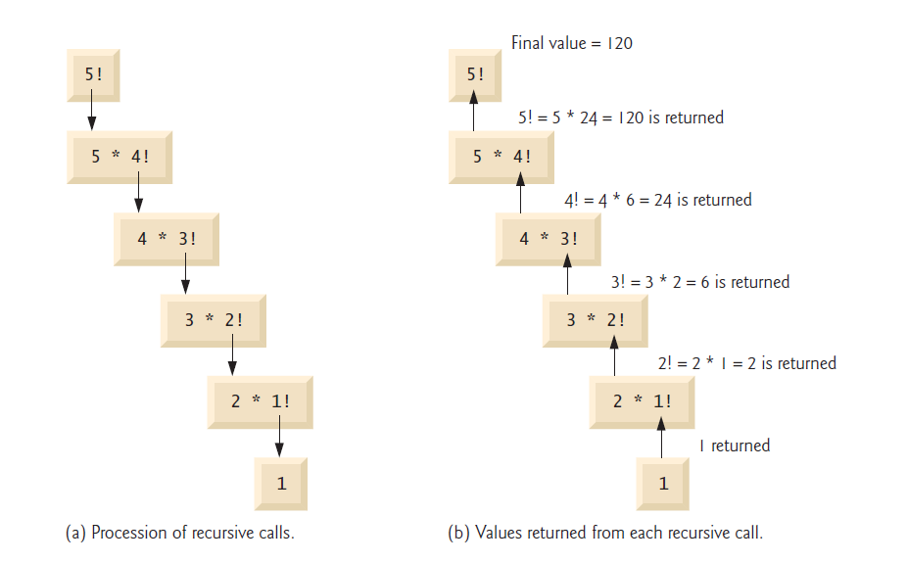
Recursive evaluation of 5!

Slide 40
19.5
Recursive Linked List Operations

Slide 41
Recursive Linked List Operations
Recursive functions can be members of a linked list class
Some applications:
Compute the size of (number of nodes in) a list
Traverse the list in reverse order

Slide 42
Counting the Nodes in a Linked List
Uses a pointer to visit each node
Algorithm:
pointer starts at head of list
If pointer is null pointer, return 0 (base case)
else, return 1 + number of nodes in the list pointed to by current node

Slide 43
// Specification file for the NumberList class
#ifndef NUMBERLIST_H
#define NUMBERLIST_H
class NumberList
{
private:
// Declare a structure for the list
struct ListNode
{
double value;
struct ListNode *next;
};
ListNode *head; // List head pointer
// Private member functions
int countNodes(ListNode *) const;
void showReverse(ListNode *) const;

Slide 44
public:
// Constructor
NumberList()
{ head = nullptr; }
// Destructor
~NumberList();
// Linked List Operations
void appendNode(double);
void insertNode(double);
void deleteNode(double);
void displayList() const;
int numNodes() const
{ return countNodes(head); }
void displayBackwards() const
{ showReverse(head); }
};
#endif

Slide 45
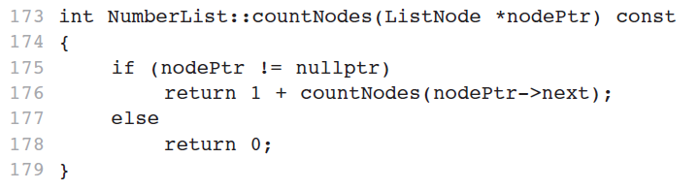

The countNodes function, a private member function
The countNodes function is executed by the public numNodes function:
int numNodes() const { return countNodes(head); }

Slide 46
Contents of a List in Reverse Order
Algorithm:
pointer starts at head of list
If the pointer is null pointer, return (base case)
If the pointer is not null pointer, advance to next node
Upon returning from recursive call, display contents of current node

Slide 47
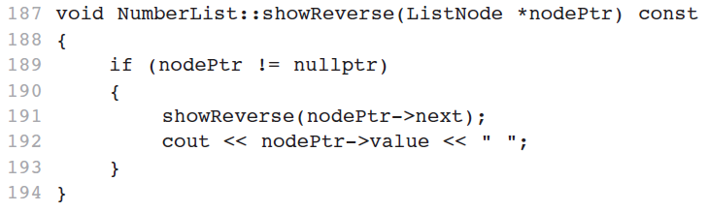
The showReverse function, a private member function
The showReverse function is executed by the public displayBackwards function:
void displayBackwards() const { showReverse(head); }

Slide 48
19.6
A Recursive Binary Search Function

Slide 49
A Recursive Binary Search Function
Binary search algorithm can easily be written to use recursion
Base cases: desired value is found, or no more array elements to search
Algorithm (array in ascending order):
If middle element of array segment is desired value, then done
Else, if the middle element is too large, repeat binary search in first half of array segment
Else, if the middle element is too small, repeat binary search on the second half of array segment

Slide 50
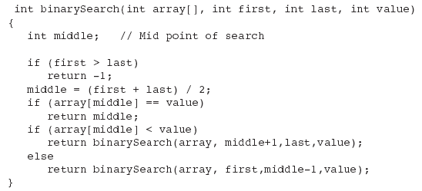
A Recursive Binary Search Function

Slide 51
19.7
The Towers of Hanoi

Slide 52
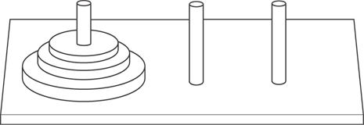
The Towers of Hanoi
The Towers of Hanoi is a mathematical game that is often used to demonstrate the power of recursion.
The game uses three pegs and a set of discs, stacked on one of the pegs.

Slide 53
The Towers of Hanoi
The object of the game is to move the discs from the first peg to the third peg. Here are the rules:
Only one disc may be moved at a time.
A disc cannot be placed on top of a smaller disc.
All discs must be stored on a peg except while being moved.

Slide 54
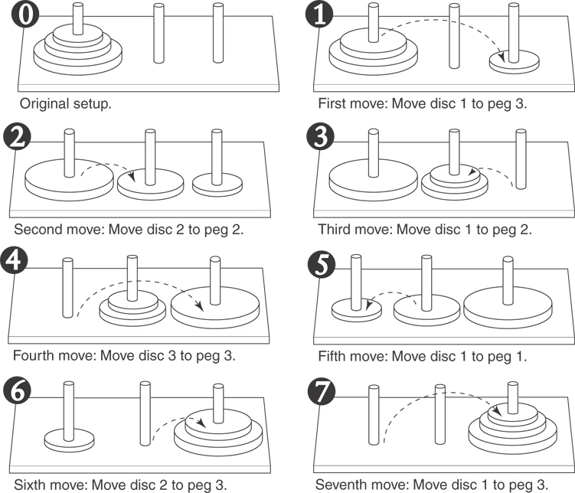
Moving Three Discs

Slide 55
The Towers of Hanoi
The following statement describes the overall solution to the problem:
Move n discs from peg 1 to peg 3 using peg 2 as a temporary peg.

Slide 56
The Towers of Hanoi
Algorithm
To move n discs from peg A to peg C, using peg B as a temporary peg: If n > 0 Then Move n – 1 discs from peg A to peg B, using peg C as a temporary peg. Move the remaining disc from the peg A to peg C. Move n – 1 discs from peg B to peg C, using peg A as a temporary peg. End If

Slide 57
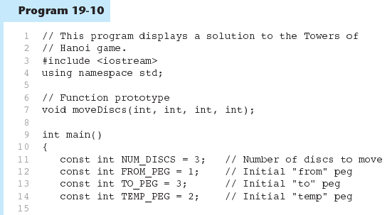

Slide 58
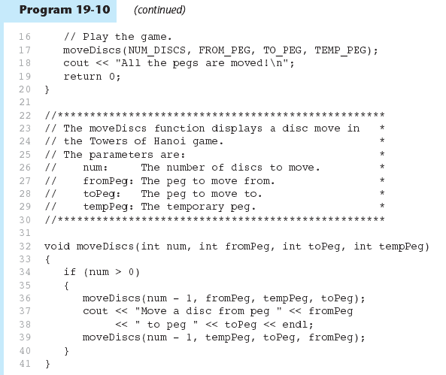

Slide 59
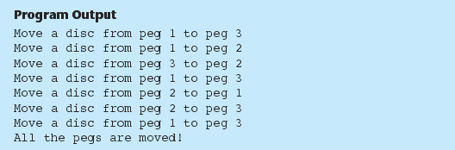
Program 19-10 (Continued)

Slide 60
19.8
The QuickSort Algorithm

Slide 61
The QuickSort Algorithm
Recursive algorithm that can sort an array or a linear linked list
Determines an element/node to use as pivot value:
pivot
sublist 1
sublist 2

Slide 62
The QuickSort Algorithm
pivot value
sublist 1
sublist 2
Once pivot value is determined, values are shifted so that elements in sublist1 are < pivot and elements in sublist2 are > pivot
Algorithm then sorts sublist1 and sublist2
Base case: sublist has size 1

Slide 63
#include <iostream>
using namespace std;
void quickSort(int [], int, int);
int partition(int [], int, int);
void swap(int &, int &);
int main()
{
const int SIZE = 10; // Array size
int count; // Loop counter
int array[SIZE] = {7, 3, 9, 2, 0, 1, 8, 4, 6, 5};
for (count = 0; count < SIZE; count++)
cout << array[count] << " ";
cout << endl;

Slide 64
// Sort the array.
quickSort(array, 0, SIZE - 1);
// Display the array contents.
for (count = 0; count < SIZE; count++)
cout << array[count] << " ";
cout << endl;
return 0;
}
void quickSort(int set[], int start, int end)
{
int pivotPoint;
if (start < end)
{
pivotPoint = partition(set, start, end);
quickSort(set, start, pivotPoint - 1);
quickSort(set, pivotPoint + 1, end);
}
}

Slide 65
int partition(int set[], int start, int end)
{
int pivotValue, pivotIndex, mid;
mid = (start + end) / 2;
swap(set[start], set[mid]);
pivotIndex = start;
pivotValue = set[start];
for (int scan = start + 1; scan <= end; scan++)
{
if (set[scan] < pivotValue)
{
pivotIndex++;
swap(set[pivotIndex], set[scan]);
}
}
swap(set[start], set[pivotIndex]);
return pivotIndex;
}

Slide 66
void swap(int &value1, int &value2)
{
int temp = value1;
value1 = value2;
value2 = temp;
}

Slide 67
Sort the following:
37 2 6 4 89 8 10 12 68 45
Starting from the rightmost element of the array, compare each element value with 37 until an element value less than 37 is found; then swap 37 and that element’s value. The first element value less than 37 is 12, so 37 and 12 are swapped. The new array is
12 2 6 4 89 8 10 37 68 45
Starting from the left of the array, but beginning with the element value after 12, compare each element value with 37 until an element value greater than 37 is found — then swap 37 and that element value. The first element value greater than 37 is 89, so 37 and 89 are swapped. The new array is
12 2 6 4 37 8 10 89 68 45

Slide 68
Starting from the right, but beginning with the element value before 89, compare each element value with 37 until an element value less than 37 is found—then swap 37 and that element value. The first element value less than 37 is 10, so 37 and 10 are swapped. The new vector is
12 2 6 4 10 8 37 89 68 45
Starting from the left, but beginning with the element value after 10, compare each element value with 37 until an element value greater than 37 is found—then swap 37 and that element value. There are no more element values greater than 37, so when we compare 37 with itself, we know that 37 has been placed in its final location of the sorted array. Every value to the left of 37 is smaller than it, and every value to the right of 37 is larger than it.
Once the partition has been applied on the previous array, there are two unsorted subarrays. The subarray with values less than 37 contains 12, 2, 6, 4, 10 and 8. The subarray with values greater than 37 contains 89, 68 and 45. The sort continues recursively, with both subarrays being partitioned in the same manner as the original array.

Slide 69
19.9
Exhaustive and Enumeration Algorithms

Slide 70
Exhaustive and Enumeration Algorithms
Exhaustive algorithm: search a set of combinations to find an optimal one
Example: change for a certain amount of money that uses the fewest coins
Uses the generation of all possible combinations when determining the optimal one.

Slide 71
19.10
Recursion vs. Iteration

Slide 72
Recursion vs. Iteration
Benefits (+), disadvantages(-) for recursion:
Models certain algorithms most accurately
Results in shorter, simpler functions
May not execute very efficiently
Benefits (+), disadvantages(-) for iteration:
Executes more efficiently than recursion
Often is harder to code or understand

Slide 73
Practice
Here is a simple recursive function to compute the Fibonacci sequence
long fibr(int n) { // Recursive Fibonacci generator
// fibr(46) is largest value that fits in a long
Assert((n > 0) && (n < 47), "Input out of range");
if ((n == 1) || (n == 2)) return 1; // Base cases
return fibr(n-1) + fibr(n-2); // Recursion
}
Function Fibi executes the for loop n – 2 times.
(a) Which version is easier to understand? Why?
(b) Explain why Fibr is so much slower than Fibi.
This algorithm turns out to be very slow, calling Fibr a total of Fib(n) times.
Contrast this with the following iterative algorithm:
long fibi(int n) { // Iterative Fibonacci generator
// fibi(46) is largest value that fits in a long
Assert((n > 0) && (n < 47), "Input out of range");
long past, prev, curr; // Store temporary values
past = prev = curr = 1; // initialize
for (int i=3; i<=n; i++) { // Compute next value
past = prev; // past holds fibi(i-2)
prev = curr; // prev holds fibi(i-1)
curr = past + prev; // curr now holds fibi(i)
}
return curr;
}

Slide 74
Practice
Most people will find the recursive form natural and easy
to understand. The iterative version requires examination of
the for loop to understand what it does, or to have confidence
that it works as claimed.
(b) Fibr is so much slower than Fibi because Fibr re-computes
The bulk of the series twice to get the two values to add. What is
much worse, the recursive calls to compute the subexpressions also
re-compute the bulk of the series, and do so recursively.
The result is an exponential explosion. In contrast, Fibi computes
each value in the series exactly once, and so its running time
is proportional to n.

Slide 75
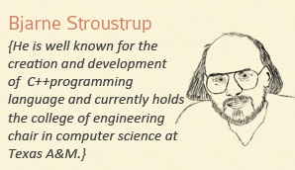
This all sounds repetitive.

Slide 76
References
Slide contributions include:
Walter Savitch, Problem solving with C++ (9th Edition). Addison-Wesley Longman Publishing Co., Inc. Boston, MA, USA ©2015
Gaddis, Starting Out with C++: From Control Structures through Objects, (8th Ed.) , Addison-Wesley Longman Publishing Co., Inc. Boston, MA, USA ©2015
Bjarne Stroustrup, The C++ Programming Language, 3rd Edition, Addison-Wesley Longman Publishing Co., Inc. Boston, MA, USA ©2007
Herb Sutter, Andrei Alexandrescu, C++ coding standards : 101 rules, guidelines, and best practices, Copyright © 2005 Pearson Education, Inc.
Paul Deitel & Harvey Deitel, C++ How to Program, (7th Ed.) © 2010 by Pearson Education, Inc.
Upper Saddle River, New Jersey 07458
Scott Meyers, Effective Modern C++. Copyright © 2015 (O’Reilly) , 978-1-491-90399-5.
Andrew Koenig and Barbara E. Moo, Accelerated C++ Practical Programming by Example,
Addison-Wesley, 2000 ISBN 0-201-70353-X

Slide 77
References
Slide contributions include:
Frank M. Carrano. Data Abstraction & Problem Solving with C++ (5th Edition)
Addison-Wesley Longman Publishing Co., Inc. Boston, MA, USA ©2006
TutorialsPoint - http://www.tutorialspoint.com/cplusplus/
Cplusplus.com - http://www.cplusplus.com/doc/tutorial/
http://www.keithschwarz.com/cs106l/fall2010/course-reader/Ch5_STLSequenceContainers.pdf

